Slide 1
Title
Live Auction System
DEPARTMENT OF INFORMATION TECHNOLOGY
GOVERNMENT POLYTECHNIC AWASARI (KHURD)
Presented By
Guidance By Group Leader
Mrs. J.G. Dabhade Shinde Siddhi
Sr. No. | Roll Number | Name of Students | Enrollment Number
1 | 22IF303 | Bangar Sarthak Nilesh | 2010510345
2 | 22IF341 | Shinde Amit Arun | 2010510390
3 | 22IF342 | Shinde Siddh Tukaram | 2010510391
4 | 22IF361 | Walse Manali Rohidas | 2010510400

Slide 2
Rationale/Abstract
Online Auction management system is a web based application which will help users to buy or sell item; they can trade anything they want by posting ad. This application will allow users to post their products for auction; bidder can register and can bid for any available product. There are some existing applications that allow users for bidding but the product is not available in your local area, you cannot do inspection of the product that you are going to buy. By online Auction application user will be able to bid for product that is available in his local area.

Slide 3
Agenda
Rationale/Abstract
Introduction
Related Work/Literature survey
Problem Definition
Proposed Methodology
System Design/Diagrams
Resources Required
Advantages, Disadvantages & Applications
Conclusion

Slide 4
Introduction
Using this online auction management system, bidders will be able to get connected to the specific sellers who will offer them necessary information and or give hand to sell their items to them. It will help save time and offer quality deliverables to the bidders by quick response and attention services. This system will replace the manual way of seeking items in the market and travelling long journeys just to get an item yet there are available items just in the neighborhood.
The scope of this application to build a user friendly auctioning website, where user will be able to auctioned any product which is available nearby or anywhere in the world. By using Online Auction management system it will be easy for auctioneer to make an auction and time saving also. By making auction through this application will help to reach maximum of buyers bidding in local area.

Slide 5
Literature Survey
1. Topic Selection and Literature Survey:
We select this topic from discussion & imagination
This is a real-time project.
We discuss with guide teacher.
2. Requirement Analysis and Software Requirement Specification(SRS).
3. Discussion with Guide
  We discuss our idea regarding this project with our Project guide Mrs. J.G. Dabhade mam, then guide suggest new tricks for implementing our idea for Live Auction System.

Slide 6
Problem Definition
To devlop an online auction ststem which will provide a forum for sellers to meet and interact with buyers and sell items to interested bidders.

Slide 7
Proposed Methodology
To develop an online auction system which will provide a forum for sellers to meet and interact with buyers, and sell items to interested bidders.
The Online auction management system shall accomplish the following as way of achieving the major goal:
To build a user friendly auctioning website, where user will be able to auction any product which is available nearby or anywhere in the world. By using Online Auction management system it will be easy for auctioneer to make an auction and time saving also. By making auction through this application will help to reach maximum of buyers bidding in local area. There will be a feature where bidder and seller can message each other

Slide 8
To implement and test the workability of the newly developed system.
1)Enable the users to view posted products in their locality and close proximity
2)Enable creation of accounts and logging in to the accounts
3)Enable users to logout of their accounts
4)Provide interface for the administrator to view the transactions, add sellers and regions to the system.
5)The sellers should also have accounts where they will receive the customer orders and respond to them.

Slide 9
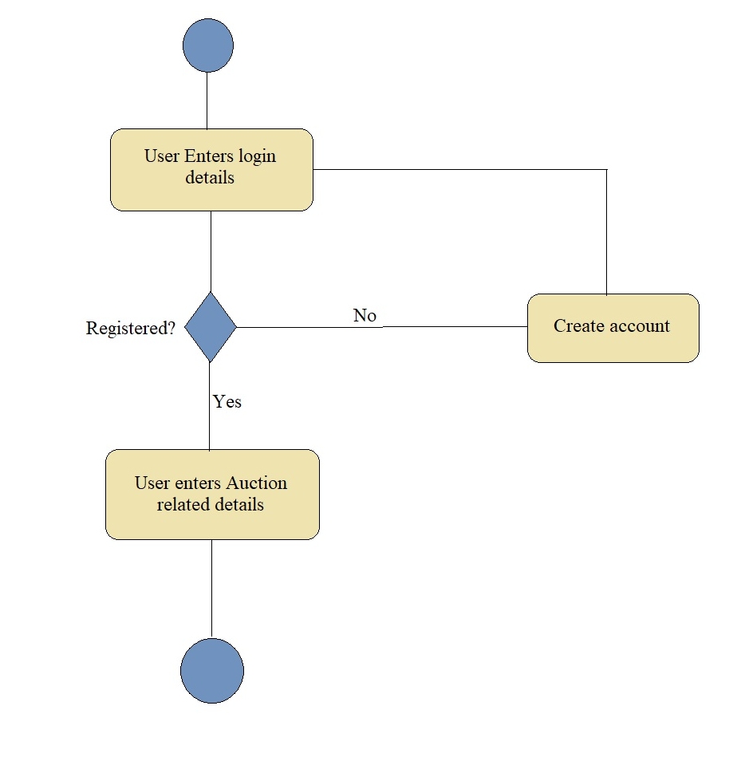
System Design
New user Registration:

Slide 10
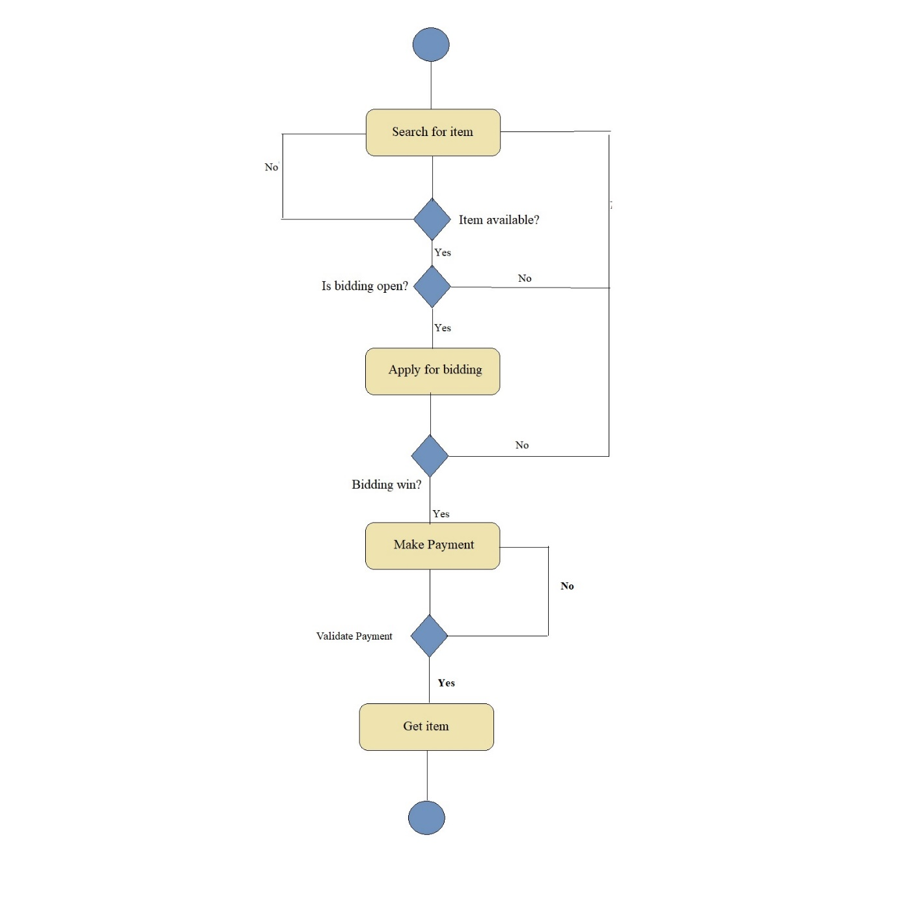
Bidding Process:

Slide 11
Resources Required
Software Requirement:
Web Template
Bootstrap
Hardware Requirement :
Ram: 4GB
Processor : Intel Core i5
HDD: 20GB

Slide 12
Advantages
More buyers.
Larger reach.
More convinient.
More cost effective.
If there are poor quality photographs then it’s of no use.

Slide 13
Disadvantages
Active Internet Connection Required
Android Smart phone with minimum 5.0 O.S required
No human interaction.
If there are poor quality photographs then it’s of no use.

Slide 14
Conclusion
The Project results in reduction of manpower & workload & staff. It benefits all the industries by reducing the complexity involved while seliing any product, rooms for the auctions. Data can be accessed anytime as it is stored in centralized database.
This application is great advantage to all the industial level as it is simplifying the biding by automatically generating the platform for the bidder, to do auction.

Slide 15
Thank You

